Slide 1
Plenty of Protocols
Unit 5.3
Cybersecurity Boot Camp |

Slide 2
Activity: Wireshark Warmup – Chat Spy (15 min)
File:
ChatSpy.pcapng
Instructions:
Somewhere within this large PCAP file is evidence of two individuals chatting whilst at work.
Your mission is to dive into this collection of packets, find their usernames, the name of the chatroom they are in, and determine the subject of their conversation.
Hint:
The display filter needed for this activity is fairly simple, but not one we've covered to date. Spend some time researching the most common protocols for online chat applications and see if you can create a display filter based on what you learn.
Once you determine the protocol, investigate how it might be possible to break down the chat conversation.

Slide 3
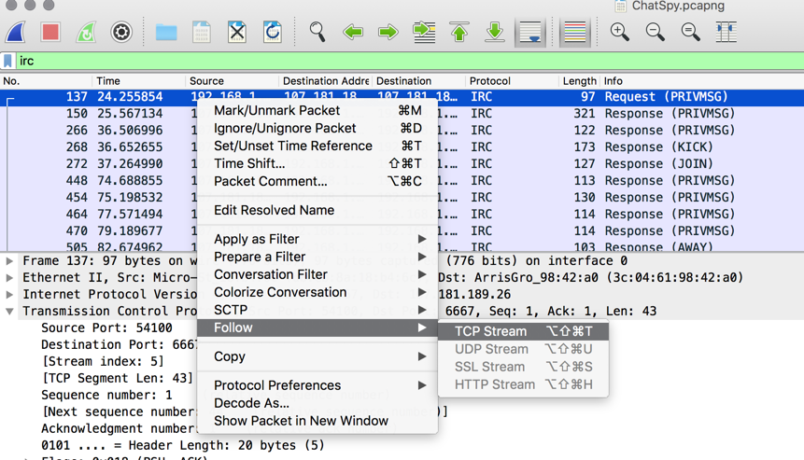
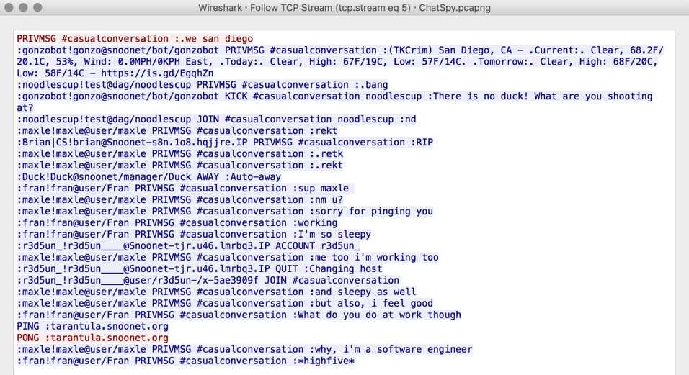
Review Chat Spy
Instructor Review

Slide 4
Intro and Intro to HTTP

Slide 5
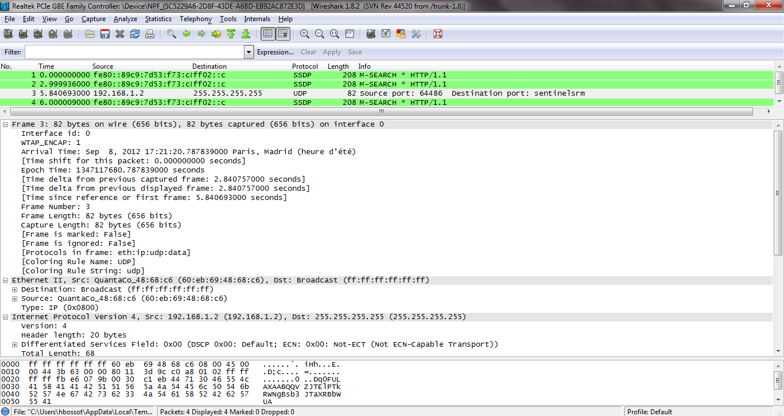


Yesterday
Wireshark, Packet Analysis
Notes:
Last class we focused on getting comfortable with wireshark

Slide 6
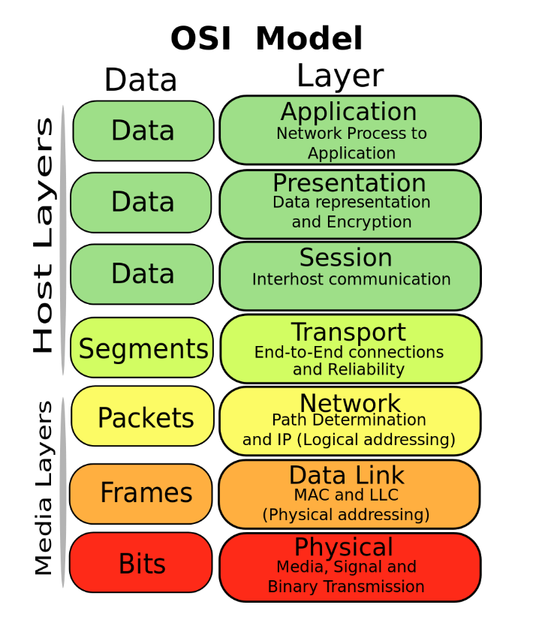
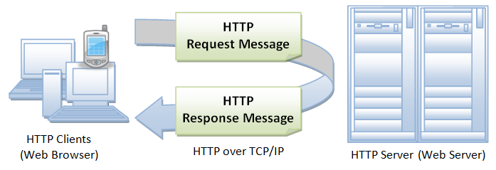
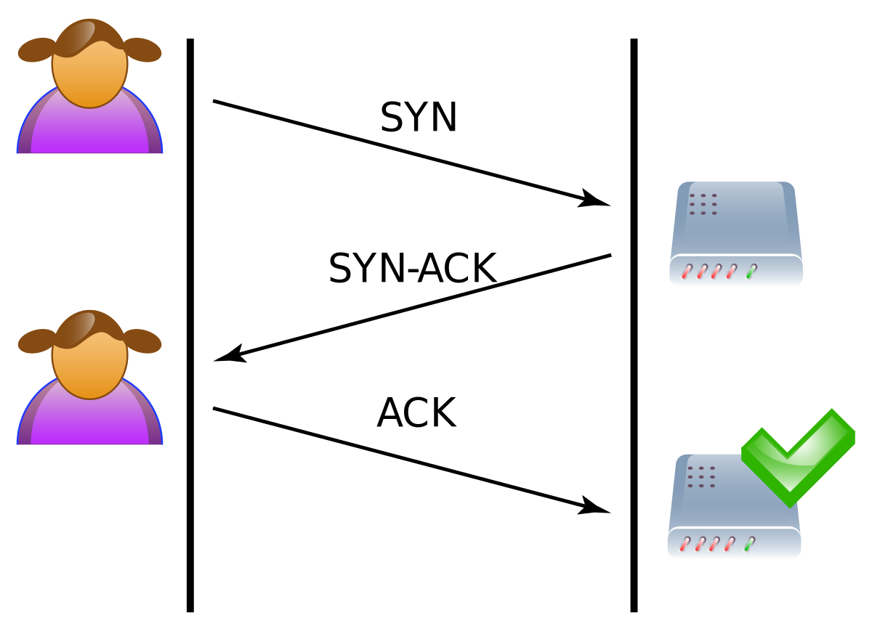
Today
Protocols and Packet Analysis
Notes:
Today we’re jumping into the deep end – looking at protocols at various layers of the OSI model.

Slide 7
Today’s Goals
By the end of class, you will be able to:
Describe the flow of typical HTTP and DNS conversations at the application layer
Explain and define IP addresses and DNS
Describe the flow of typical TCP conversations
Describe a port and how it relates to protocols
Describe which protocols belong to what part of the OSI model
Identify and analyze communication over common protocols with Wireshark
Notes:
But today, we’re going to… Review goals, address questions.

Slide 8
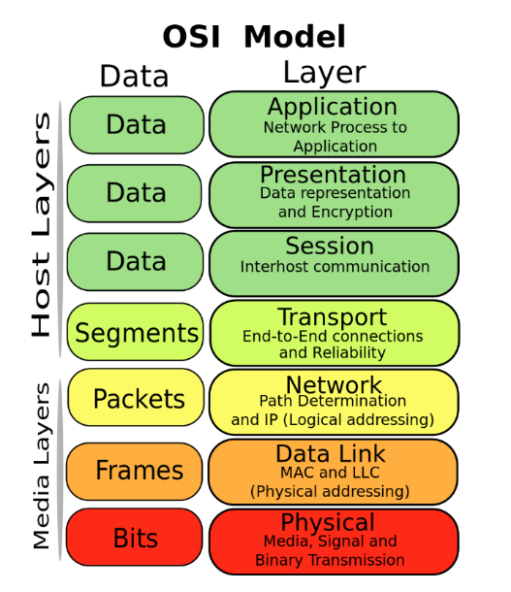
HTTP
Hypertext Transfer Protocol
An application-layer protocol designed for communication between web browsers and web servers

Slide 9

HTTP
Uses typical client/server architecture.
Used to communicate:
HTML Files
Images
…

Slide 10
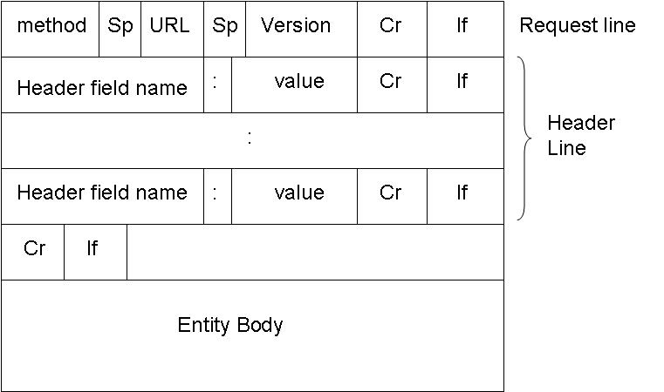
HTTP Request
HTTP can be thought of as a series of request/response cycles.
“A client sends an HTTP request to a server in the form of a request message, beginning with a request-line that includes a method, URI, and protocol version…, followed by header fields containing request modifiers, client information, and representation metadata…, an empty line to indicate the end of the header section, and finally a message body containing the payload body.”.
Model:
[Method] /[Resource URI] HTTP/[Version]
Header Name: Value
Header Name: Value
Header Name: Value
<Empty Line>
- RFC 7230
Example HTTP Request:
GET /hello.txt HTTP/1.1
User-Agent: curl/7.16.3 libcurl/7.16.3 OpenSSL/0.9.7l zlib/1.2.3
Host: www.example.com
Accept-Language: en, mi

Slide 11
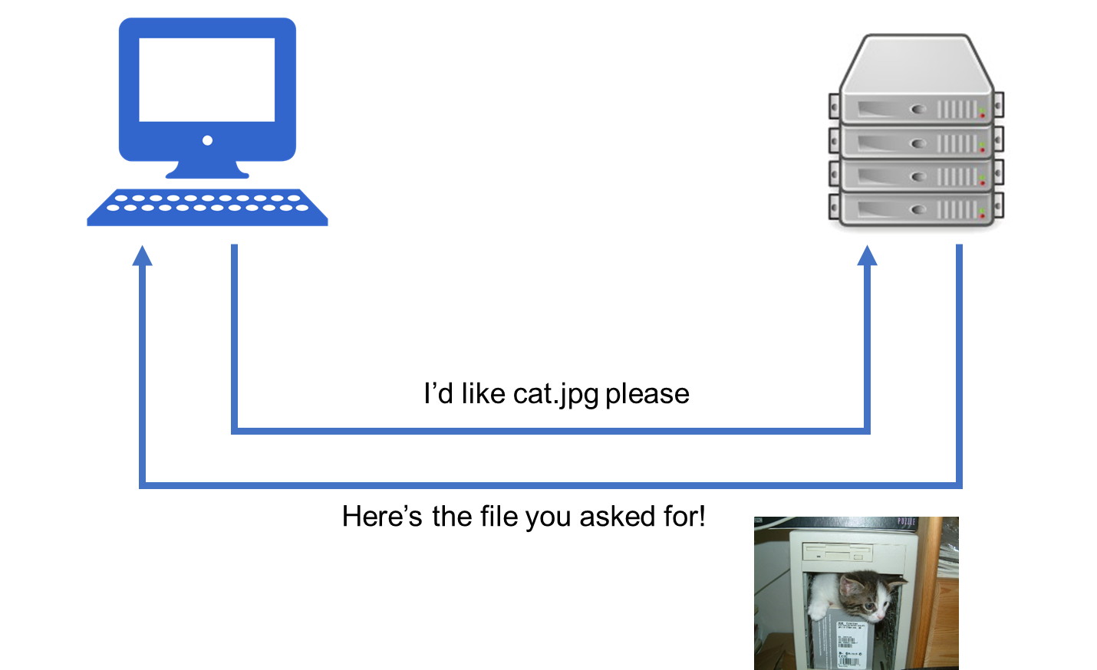
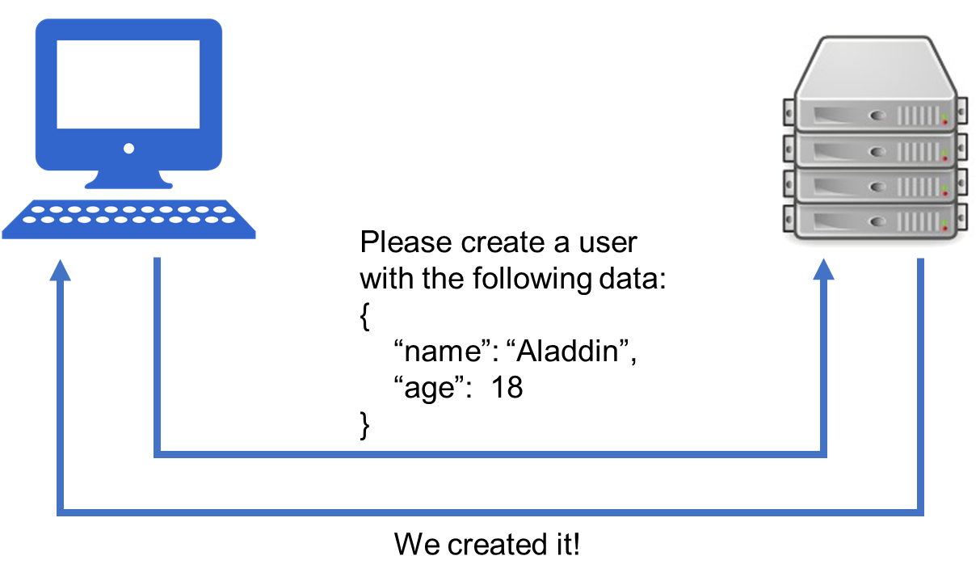
HTTP Request Methods
Requests must indicate what action they want the server to take, called the method.
POST /users HTTP/1.1 … { “name”: “Aladdin”, “age”: 18 }
GET /cat.jpg HTTP/1.1
Notes:
Status codes are numbers which indicate how the server dealt with the response, and/or other problems that may have been encountered.

Slide 12
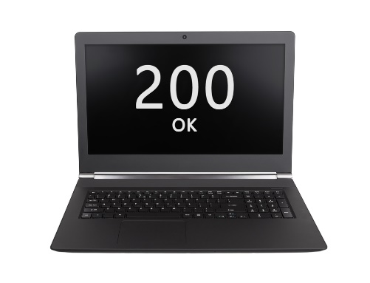
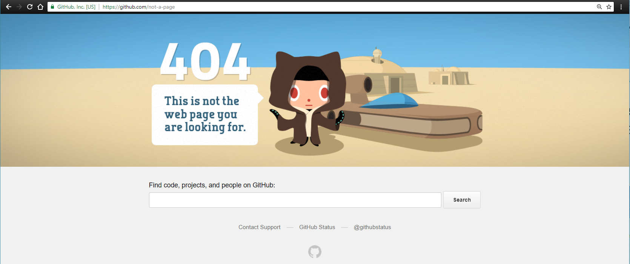
HTTP Status Codes
Responses from the server include the response body (e.g. file) and a status code to indicate how the response went.
Notes:
Status codes are numbers which indicate how the server dealt with the response, and/or other problems that may have been encountered.

Slide 13
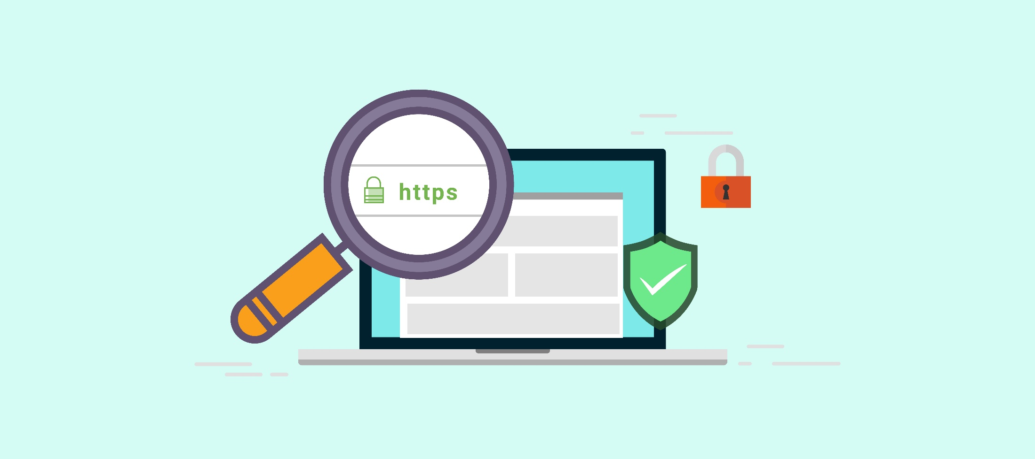
HTTP vs HTTPs
HTTPs (HTTP Secure) uses an SSL certificate (TLS) to encrypt data before sending, and decrypt upon arrival

Slide 14
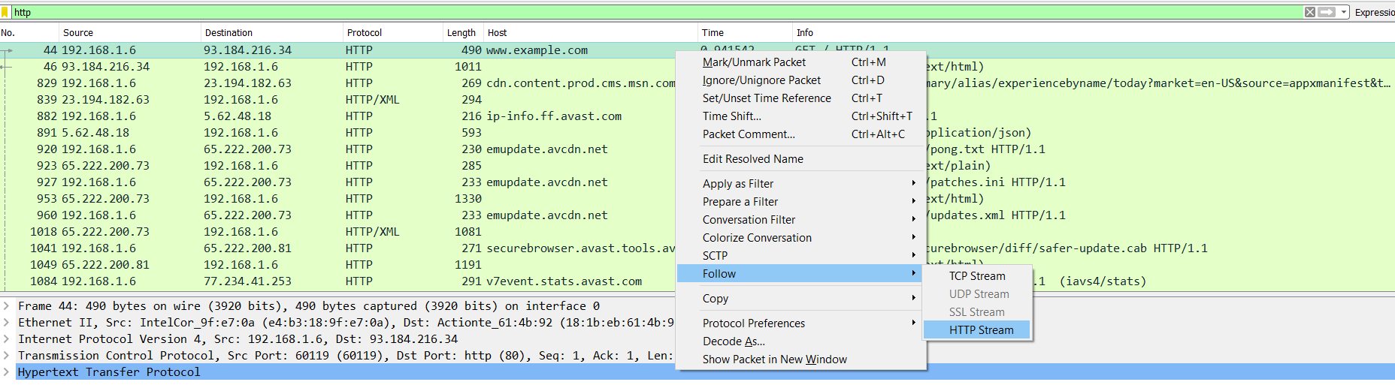
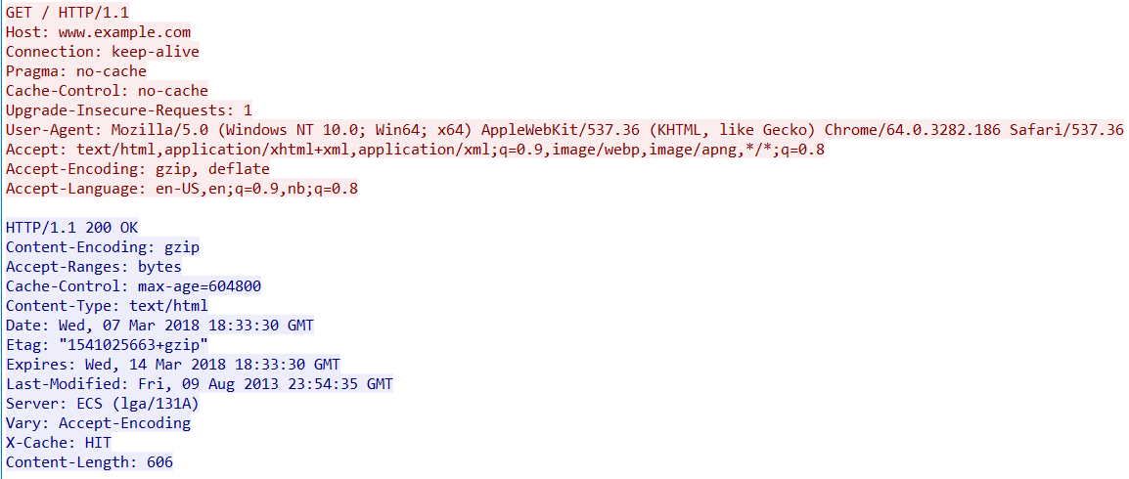
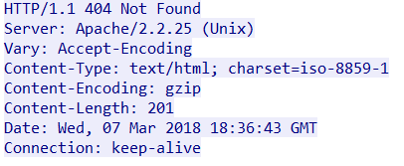
Wireshark HTTP Demo
Instructor Demo

Slide 15
Activity: Wireshark HTTP Analysis (10 min)
In this activity, you'll peer into HTTP conversations and start to reverse-engineer HTTP protocol.
Instructions:
Using the PCAP files and instructions sent to you, investigate the files to answer the questions presented.

Slide 16
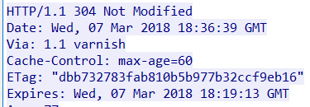
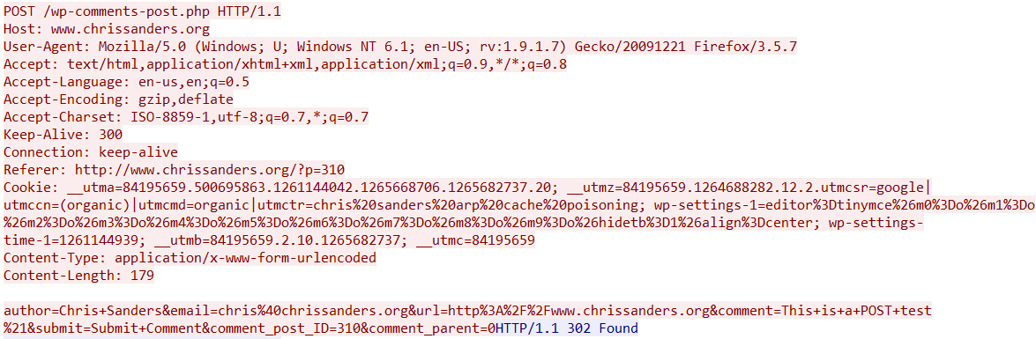
Review Wireshark HTTP Analysis
Instructor Review

Slide 17
DNS

Slide 18

DNS
Hi, can you please send me Google’s webpage?
I don’t know what that is. Do you have an IP address?
...

Slide 19
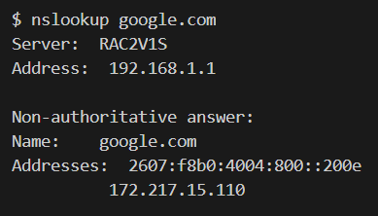
Domain Names
Computers use IP addresses to locate and communicate with other computers
But … 172.217.15.110 isn’t the most memorable for humans
Domain names enable us to use google.com instead of 172.217.15.110

Slide 20
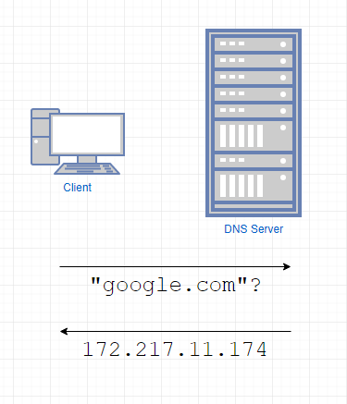
DNS
Domain Name System
An application-layer protocol designed to translate domain names into IP addresses

Slide 21
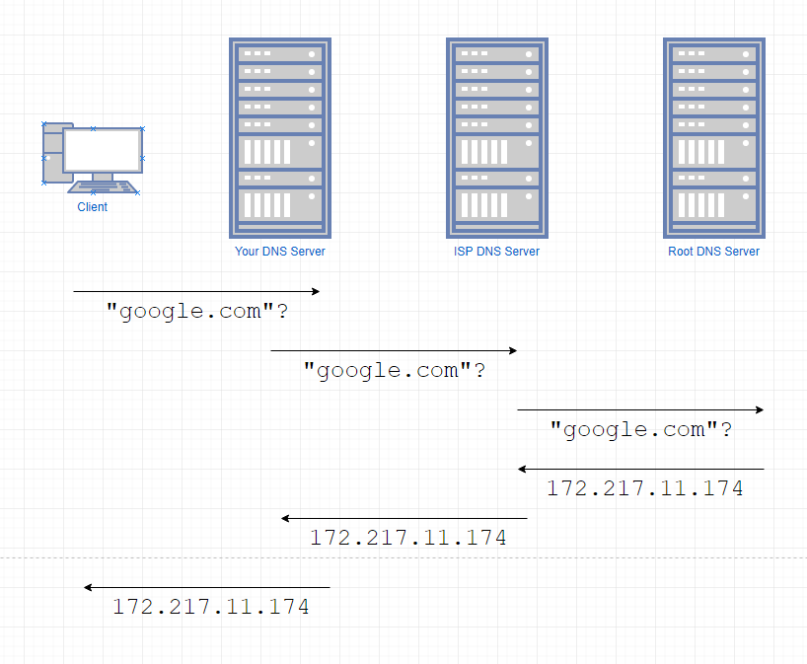
DNS Lookups
DNS Lookups involve bouncing from server to server until the correct IP is found.

Slide 22
DNS Resolutions
A DNS resolution happens any time you use a domain name in any application.
nslookup is a command line tool that allows you to do a manual DNS resolution
Notes:
Resolving the domain name

Slide 23
DNS Resolutions
Sometimes, you’ll have a domain name that’s for a device in your network.
Say you own “iAmTheBest.com” but you also have:
mail.iAmTheBest.com
blog.iAmTheBest.com
music.iAmTheBest.com
You would need your own “nameserver” to handle requests to these URLs
“mail”, “blog”, and “music” in these cases are called “subdomains”
Notes:
Resolving the domain name

Slide 24
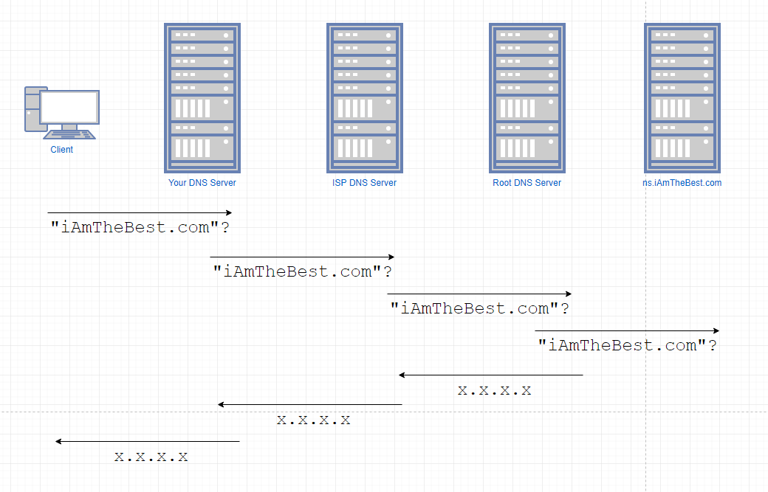
DNS Resolutions
Notes:
Resolving the domain name

Slide 25
DNS Record Types
DNS allows you to query for more than just domain -> IP address. These other features are called record types:
A record - IPv4 address from a hostname query
AAAA record - IPv6 address from a hostname query
MX record - mail server for the domain
CNAME - alias to the domain name
NS record - nameserver of the domain
PTR record - hostname from an IP address
…plus many more.

Slide 26
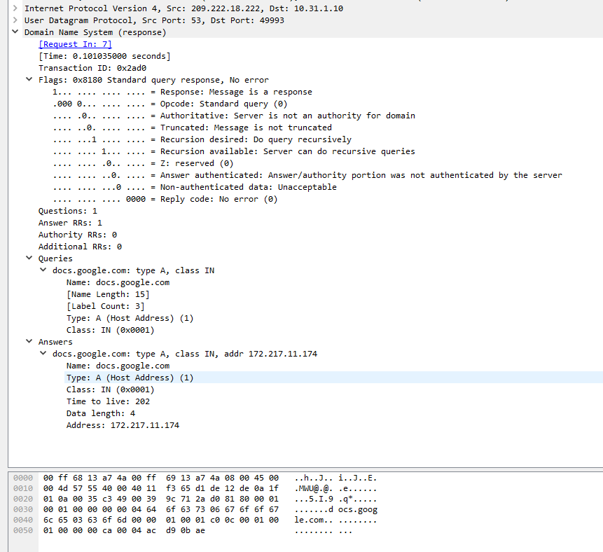
Demo: DNS in Wireshark
DNS packets include flags which indicate information about the packet
If the first bit is ‘0’, it’s a request
If the first bit is ‘1’, it’s a response!
Flags are followed by actual data
flags
original query and answer

Slide 27
Activity: Wireshark DNS Analysis (10 min)
Instructions:
Part 1:
Open the `dns-1.pcap` file.
This file only contains DNS replies. How many DNS requests were there?
When the user asked for `assets.espn.go.com`, what happened?
What is/are the IP address(es) for `a1.espncdn.com`?
Part 2:
Open the `dns-2.pcap` file.
This capture contains an attempted query, but something went wrong.
What happened?
Which flag in the packet reveals what went wrong?
The request went to 8.8.8.8. Did the response come directly from 8.8.8.8?

Slide 28
Review Wireshark DNS Analysis
Instructor Review

Slide 29
Ports

Slide 30

Ports
Ports
A transport-layer concept, associated with handling end-to-end communication
“Docking point” through which information flows to a specific program

Slide 31
Ports
Ports
Session layer uses ports defined in layer 4 to handle communication between programs and devices
Not really a neat/clear mapping…
IP + Port = Who + What
Notes:
Liken to a boat port

Slide 32
OSI Recap
Layer 7: Interaction with application to view/create data.
Layer 6: Translates data to/from application to network format
Layer 5: Coordinates conversations between applications at each end.
Layer 4: Ensures complete data transfer between systems.
Notes:
Liken to a boat port

Slide 33
Port Numbers and Ranges
0 to 1023 – System Ports
Well known port numbers, well-defined port numbers
Most common protocols are in this range
1024 to 49151 – Registered Ports
Assigned as Requested to the IANA for specific services
49152 to 65536 – Dynamic / Private Ports (Unregistered)
Can’t be registered – for private or customized services
DNS - 53
Microsoft SQL Server - 1433
Notes:
Liken to a boat port

Slide 34
Port Numbers and Ranges
Source Ports
Source ports are randomly generated from the unregistered port range.
Destination Ports
Dependent on the protocol
188.4.4.72
151.20.0.145
151.20.0.145 Port: 80
188.4.4.72 Port 50158
Notes:
Liken to a boat port

Slide 35
Common Ports
Protocol | Port
FTP | 20
FTP | 21
SSH | 22
Telnet | 23
SMTP | 25
DNS | 53
HTTP | 80
POP3 | 110
IRC | 194
HTTPs | 443
Notes:
Liken to a boat port

Slide 36
Activity: Wireshark Port Identification (8 min)
Files:
05-Stu_Ports/ports1.pcap
05-Stu_Ports/ports2.pcap
Instructions:
For each PCAP file, answer the following:
Who is the sender? What port is the sender using?
Who is the receiver? What port is the receiver using?
What protocol is being used?
Investigate and write a sentence or two about the purpose of the protocol and how it works. See if you can identify individual steps in communication associated with the protocol.

Slide 37
Review Wireshark Port Identification
Instructor Review

Slide 38
Break (40 min)

Slide 39
Transport Layer Protocols

Slide 40
Recap - Application Layer Protocols
What is the purpose of an application-layer protocol?

Slide 41
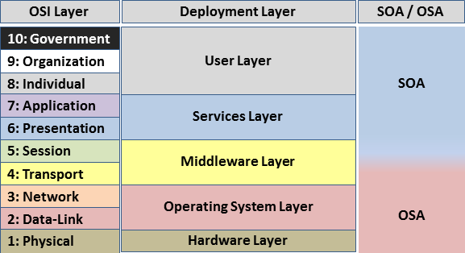
Transport Layer Protocols
Transport Layer Protocols
Transport layer is responsible for end-to-end communication over a network – sending data to the appropriate application.
Works with session layer to manage connections between applications on different machines

Slide 42
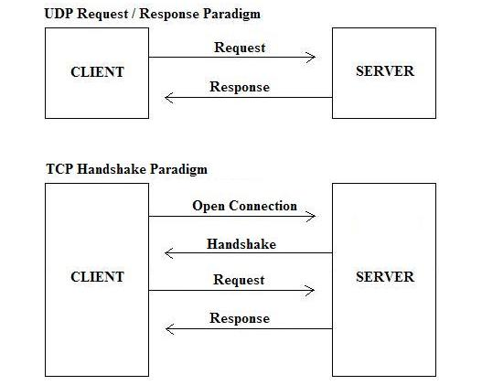
Transport Layer Protocols
Two most common protocols: UDP and TCP

Slide 43
UDP
UDP
“Connectionless’”
Used by DNS, VoIP, Streaming media
Used when you don’t care if you always get data

Slide 44
UDP
Unconcerned with whether the response was received.
Typically faster, but data can be lost.
Simple request, response. No setup.

Slide 45
TCP
Used by HTTP, FTP, SSH, SMTP, and more.
Used when all transmitted data must be received
Presents “socket” to upper layers – simple abstraction to write/read to/from

Slide 46
TCP
Considered more safe and reliable than UDP.
Doesn’t send data until receives acknowledgement.
Sets up and confirms a connection before making a request.

Slide 47
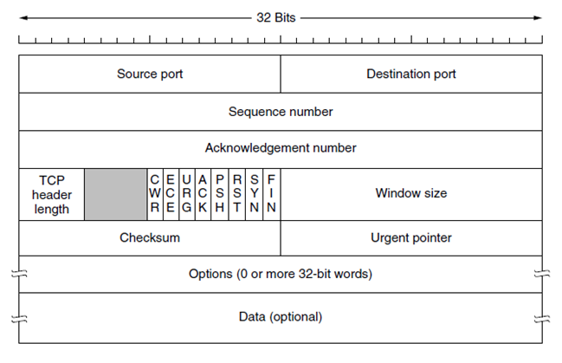
TCP – Headers and Flags
TCP header contains the number of the packet in a sequence, source and destination ports
Header includes flags to indicate what kind of TCP message is contained within:
CWR
ECE
URG
ACK
PSH
RST
SYN
FIN

Slide 48
TCP – Headers and Flags
SYN – Synchronization – first step in establishing handshake between hosts
ACK – Acknowledgement – used to acknowledge successful receipt of a packet
PSH – Push – tell recipient to process this packet as it is received, don’t buffer it
RST – Reset – sent when a packet was sent that was unexpected
FIN – Synchronization – first step in establishing handshake between hosts

Slide 49
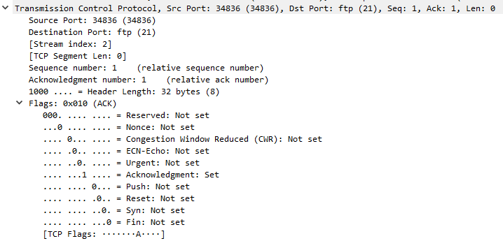
TCP – Headers and Flags
Flags in TCP Header

Slide 50
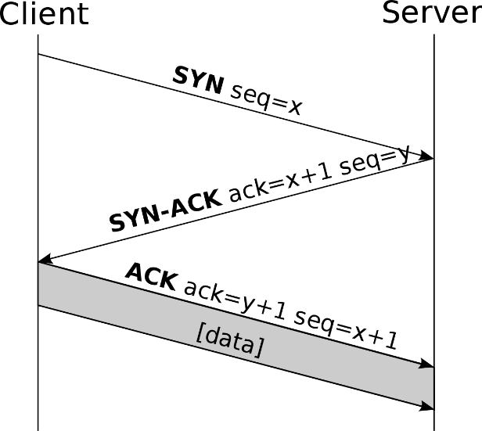
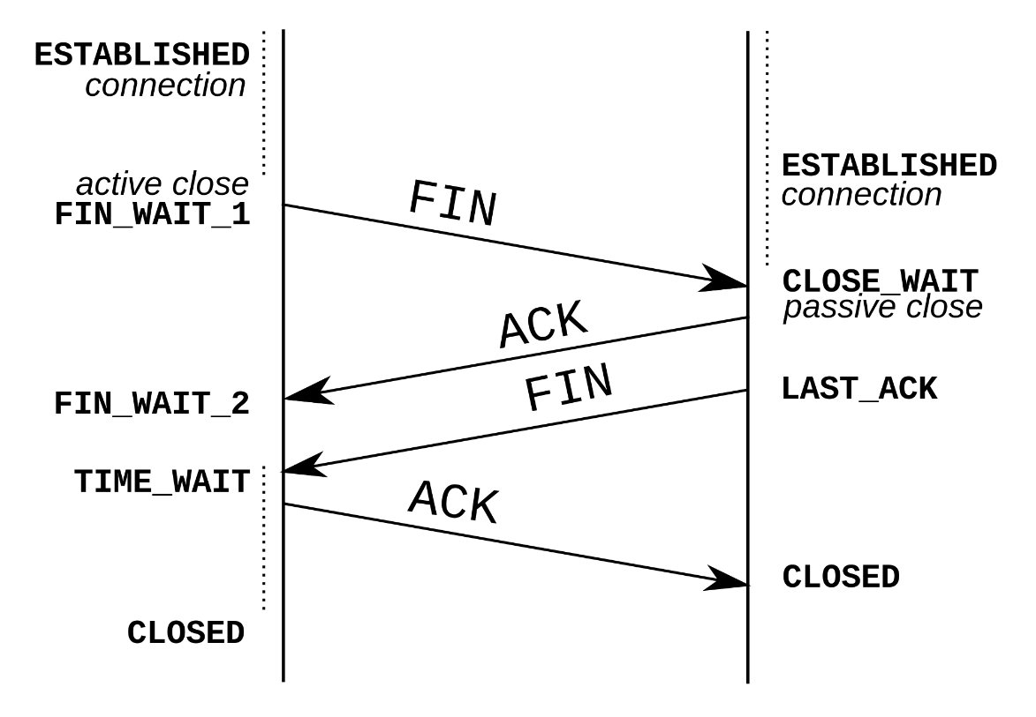
TCP
TCP Handshake
Connection-Oriented
3-way handshake, 4-way close
Setup: SYN, SYN-ACK, ACK
Teardown: FIN, ACK, FIN, ACK
Notes:
Both ends can initiate and negotiate separate TCP socket connections at the same time, allowing for multiple simultaneous TCP data streams.
After connection established, either end can initiate a FIN

Slide 51

TCP vs UDP
You want your friend’s toy.
TCP
You call his phone number.
He picks up and says “Howdy, Buzz”
You say “Hey, Woody”
You ask for the toy.
He sends you the toy.
UDP
1. You call and leave a voicemail that you want his toy.
2. Your toy might come in the mail.
3-way handshake
Notes:
In the analogy, the phone number is the IP + Port
He knows it’s you when he picks up because of “caller id” – information about who you are was sent with your call. (SYN)

Slide 52
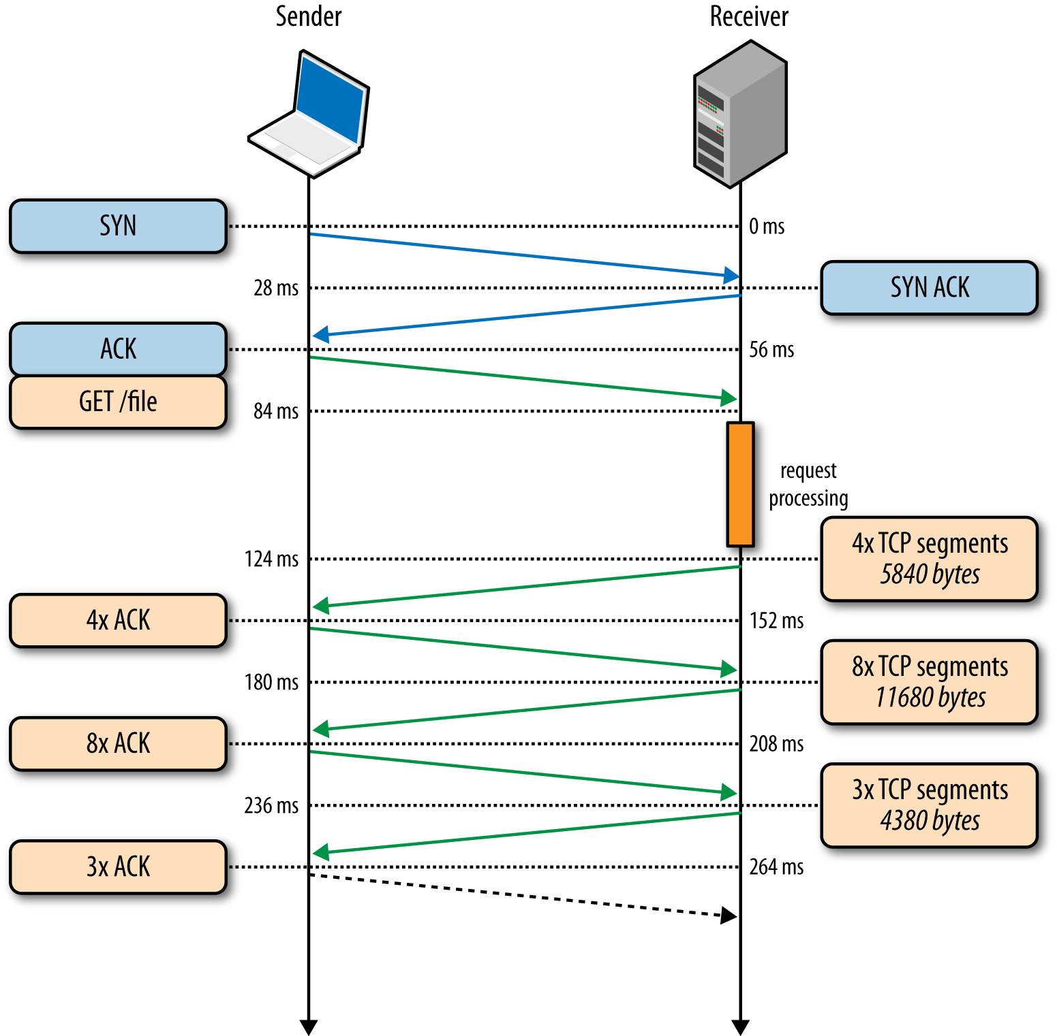
TCP with Request/Response

Slide 53
TCP vs. UDP - Jokes
In high society, TCP is more welcome than UDP. At least it knows a proper handshake.
I’d tell you a UDP joke but you might not get it.

Slide 54
Activity: Explain/Draw the Process (10 min)
You now know all of the basics of what happens in layers 4-7 of the OSI Model. Let’s practice explaining it!
Instructions:
Draw the process of request/response for an HTTP page through the network in the context of the OSI model, labelling:
The protocol(s) used at each layer
How the protocol works at that stage of the process
The format of the data at that point in the layer
When confident in your drawing, compare with your partner’s drawing. Try to explain your diagram, and note any differences between the two.
Act out the TCP communication and handshake process with your partner.
Challenge: Do the same for DNS
Note: Being able to explain this is a critical skill! Don’t skim over any areas you’re uncertain about – dive in!

Slide 55
Activity: Digging into TCP Communications (15 min)
Let’s investigate TCP in action!
Instructions:
Open the `tcp.pcapng` file with Wireshark
Filter for TCP packets only.
Find all TCP SYN packets.
Find all TCP FIN packets.
Filter for a single TCP stream using the "FTP" protocol.
Find the 3-way handshake sequence.
Find the TCP teardown sequence.
What are the source/destination IP addresses and ports?

Slide 56
Review Digging Into TCP Communications
Instructor Review

Slide 57
Case Study: Syn Scan

Slide 58
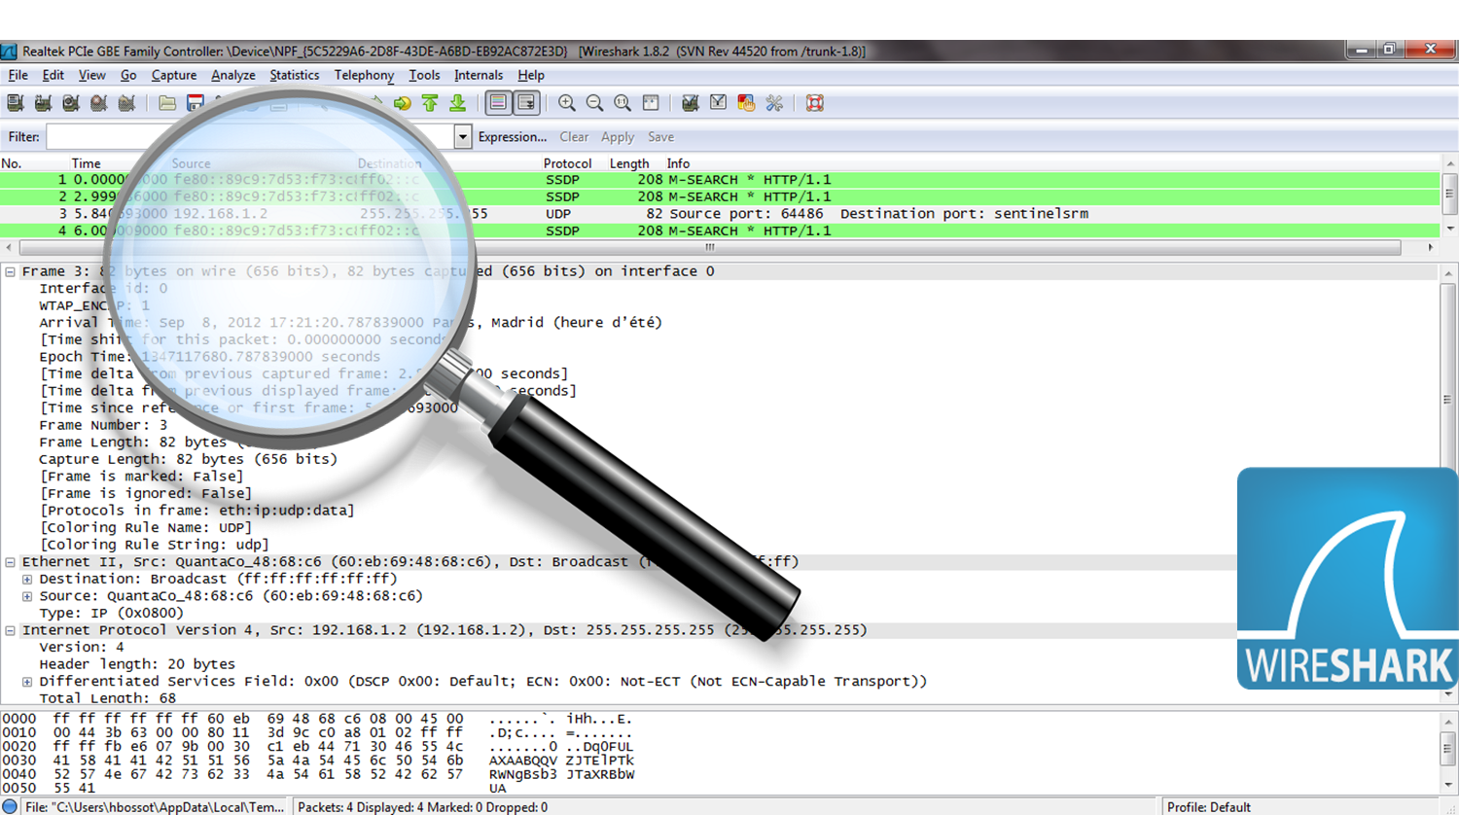
This Week
With TCP streams, we can see everything.
Notes:
This week we talked about the Host layers of the OSI model and associated protocols. Explain that since TCP streams contain the raw data transferred between devices, they really do tell the full story of what happened on the network.
- Inspecting TCP traffic reveals suspicious patterns that are invisible above the transport layer. Namely:
- It contains records of attacks or surveillance people have performed on our machines.
- Just as it contains data for images, CSVs, etc., transferred over the network, it also contains the raw data of malicious files, such as viruses and trojans, that travel over the network.

Slide 59
Syn Scan
Identifying Scans
To start a connection, source machine sends a SYN packet.
Target then sends a SYN-ACK if it’s willing to accept a connection on that port.
Notes:
In the analogy, the phone number is the IP + Port
He knows it’s you when he picks up because of “caller id” – information about who you are was sent with your call. (SYN)

Slide 60
Syn Scan
So what if we send a request to every port on a machine?
What would the responses tell us?

Slide 61
Syn Scan
Identifying Scans
Any ports that respond may be vulnerable or open.
Notes:
In the analogy, the phone number is the IP + Port
He knows it’s you when he picks up because of “caller id” – information about who you are was sent with your call. (SYN)

Slide 62
Activity: Syn Scan (15 min)
File: 08-Par_SynScan/synscan.pcapng
Instructions:
For each of the ports 80, 443, and 113, filter the traffic by that port number and answer the following:
What protocol is associated with that port?
Who is sending the SYN packet?
Did the recipient acknowledge the request?
What does the response likely mean for whether that port is accessible and/or accepting connections? (use your knowledge of the handshake!)
Open the “Conversations” window (Statistics -> Conversations), and sort the conversations by the packets column (packet count), descending.
Based on what you see here, what other ports might be open, closed, or inaccessible? What protocols are associated with those ports?
Who seems to be doing the syn scan?

Slide 63
Syn Scan Review
Instructor Review

Slide 64
Lesson Recap

Slide 65
Today’s Goals
By the end of class, you will be able to:
Describe the flow of typical HTTP and DNS conversations at the application layer
Explain and define IP addresses and DNS
Describe the flow of typical TCP conversations
Describe a port and how it relates to protocols
Describe which protocols belong to what part of the OSI model
Identify and analyze communication over common protocols with Wireshark
Notes:
But today, we’re going to… Review goals, address questions.

Slide 66
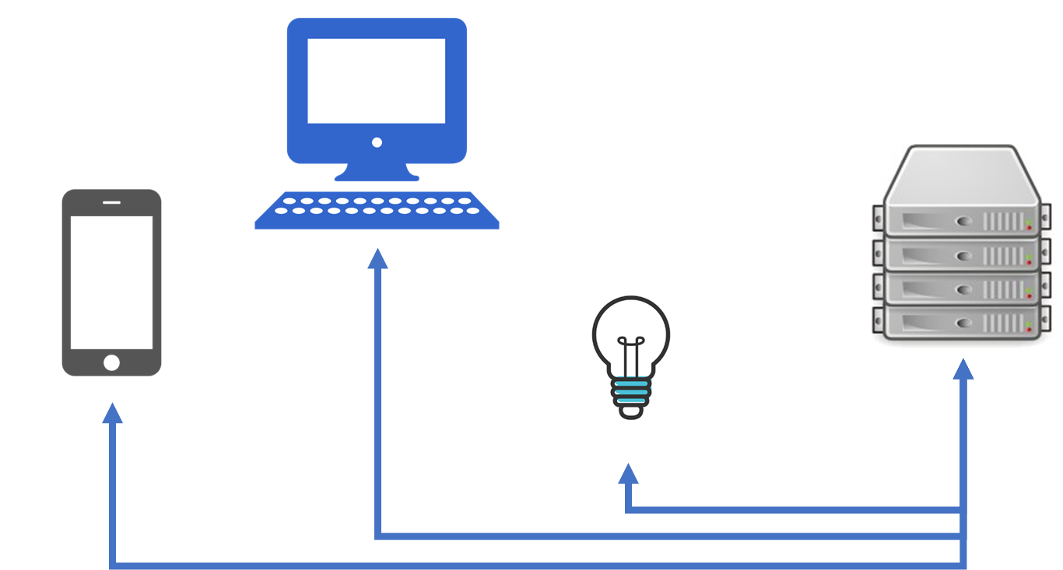
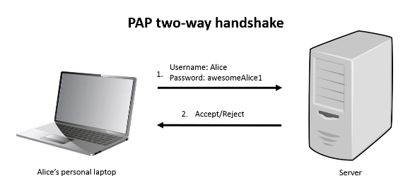
This Week
Networking, Protocols, OSI Host Layers, Wireshark, Packet Analysis and Sniffing
Notes:
This week we talked about the Host layers of the OSI model and associated protocols.

Slide 67
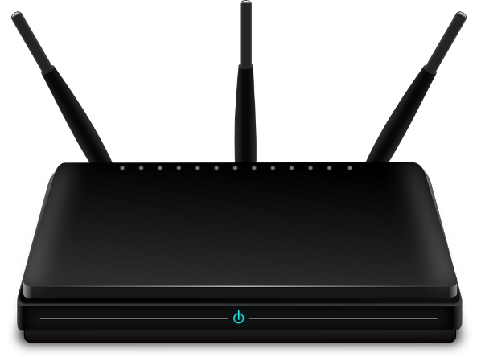
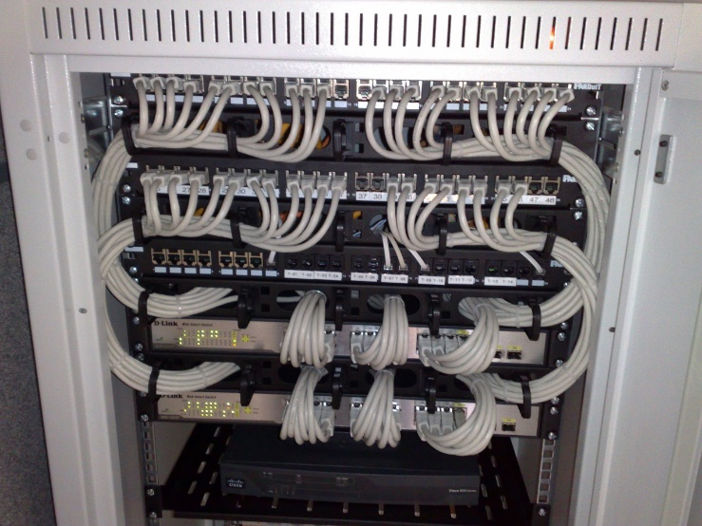
Next Week
OSI Media Layers, Network Devices and Hardware, Packet Tracer
Notes:
Now we have a pretty good understanding of application layer and transport/internet layer protocols - next week we'll talk about data link and physical layers, and what devices and hardware make networks possible

Slide 68
References
https://developers.google.com/speed/public-dns/
https://www.godaddy.com/help/what-is-dns-665
https://www.whois.com.au/whois/dns.html
https://www.verisign.com/en_US/website-presence/online/how-dns-works/index.xhtml
Not a reference but a cute comic about how DNS works: https://howdns.works/
ELI5 TCP: https://dev.to/themikenicholson/comment/1282
Hilariously animated explanation of ports/network communication: https://www.youtube.com/watch?v=PBWhzz_Gn10
https://www.keycdn.com/support/tcp-flags/

